Slide 1
Exploring the links between heterosis and protein metabolism
Steve Goff
iPlant Collaborative
January, 2013

Slide 2
Presentation Outline
Background information:
  iPlant
  Heterosis and inbreeding
  Gene expression studies to understand heterosis
  Protein metabolism
  Aging
Creation of a hypothesis
Testing the hypothesis
Future experimental approaches
Implications for healthy aging & food production

Slide 3

Darwin (1876) Then Shull (1908) Described Hybrid Vigor
Darwin- described barriers to inbreeding
Shull - Inbred maize & created hybrid crosses
Described inbreeding depression & heterosis
East & Shull – Dominance/Overdominance
Epistasis added as a third model

Slide 4
Any Theory Should Explain Why
Heterosis:
Increases cell proliferation
Does not change developmental progression
Is present after purging obvious detrimental alleles
Is higher in progressive polyploids vs autopolyploids
Is higher with increasing genetic difference (to a limit)
Is dosage dependent
Is decreased by aneuploidy
Alters circadian gene expression in inbreds vs hybrids
Is proportional to the number of alleles
Is proportional to the level of additive gene expression

Slide 5
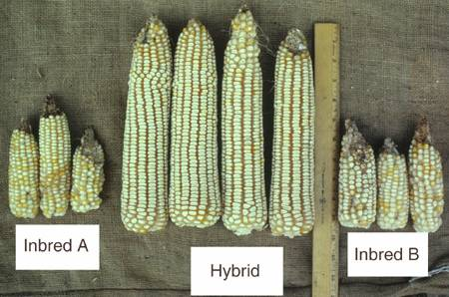
What’s the Molecular Explanation for this Growth Difference?
Inbred A
Inbred B
Hybrid

Slide 6
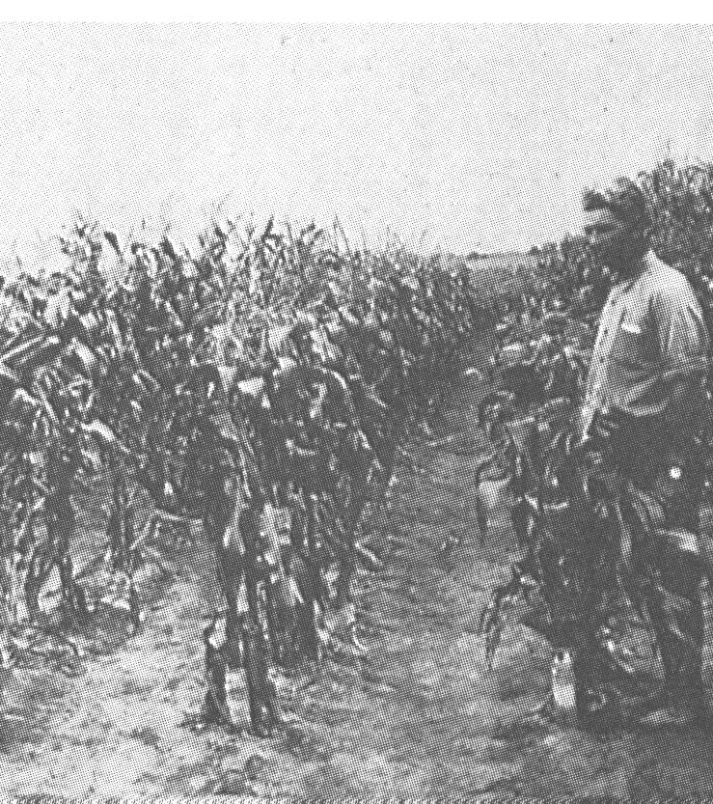
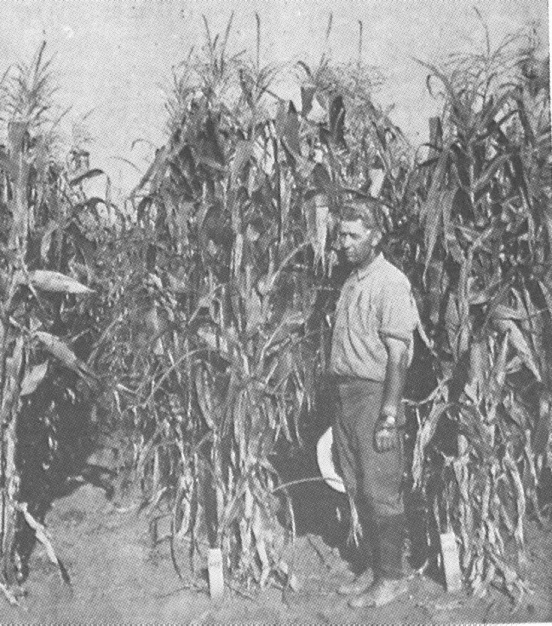
Understanding Yield - Maize Hybrid Vigor
Inbreds (12th generation)
First generation hybrid
(Nebraska Agricultural Experiment Station, 1922)

Slide 7
Maize Yields Over Decades
US Average Corn Yield
200
Biotech Crops
150
Increased Use of Hybrids
100
Bushels/acre
50
0
1920
1930
1940
1950
1960
1970
1980
1990
2000
2010E
Source: USDA, Dr. A. Troyer

Slide 8
Yield of 42 Hybrids & Inbred Parents
30K plants/ha, 3 locations/yr.
10000
9000
Hybrids
8000
7000
6000
Grain yield (kg/ha)
5000
4000
3000
Inbreds
2000
1000
Duvick,1999
0
1920
1930
1940
1950
1960
1970
1980
1990
Decade of commercial use

Slide 9
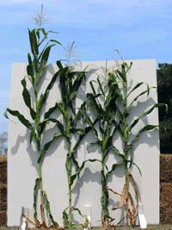
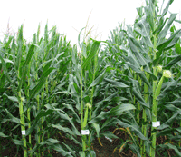
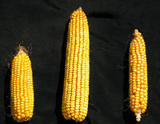
Hybrid Vigor & Inbreeding Depression
Two Sides of the Same Coin
Mo17 and B73 inbreds and hybrid
Inbreeding depression
Hybrid inbreds

Slide 10
Hybrid Vigor – What I think
Cells “choose” which allele to express
“Choice” is based on protein folding & stability
Homozygous Inbreds can’t choose, hybrids can
Inbreds degrade more protein from expressed weak alleles
Unfolded proteins decrease cell cycle progression
Autopolyploids are essentially like diploids
Allopolyploids have more alleles to choose from
Aneuploids have altered protein subunit balance
Aneuploids degrade more protein and grow slower
Down-regulation of some alleles saves energy
Energy savings promotes faster growth
Unclear what % of growth difference this accounts for
Goff, A unifying theory for general multigenic heterosis: energy efficiency, protein metabolism, and implications for molecular breeding. New Phytologist 189: p923-937 (2011)

Slide 11
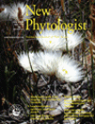
Hybrid Vigor (Heterosis) & Yield
Yield is the most important trait for farmers
Yield is inversely correlated with “stress”
Hybrids are more “stress” resistant
Energy used for one trait is lost to another
What are the stresses?
Where does the energy go?
Theory in:
Goff, S. A. (2011). New Phytologist 189: 923-937.

Slide 12

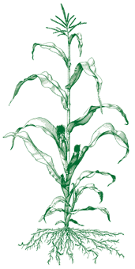
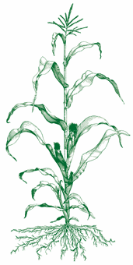
Working Model for Crop Yield
Hybrid Crop
Inbred Crop
Energy
Energy
Growth
(Cell division)
Recycling
Proteins & mRNAs
Growth
(cell division)
Recycling
Proteins & mRNAs

Slide 13

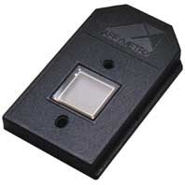
Background
Shotgun Sequenced Rice
Assembled with BAC Fingerprints & Ends
Created Rice and Maize Affymetric Chips
400-600k Oligos - 30-60k Genes
Goff et al Science 296: 92-100 (2002).
Goff & Salmeron Scientific American (August 2004)

Slide 14
Hybrid Vigor Theories
Dominance – Complementation of weak alleles
Overdominance – Interaction of good alleles
Epistasis – Interaction of genes
Not mutually exclusive
Model do not explain all observations:
  Aneuploids
  Autopolyploids vs allopolyploids
  Circadian rhythms
  Cell cycle

Slide 15
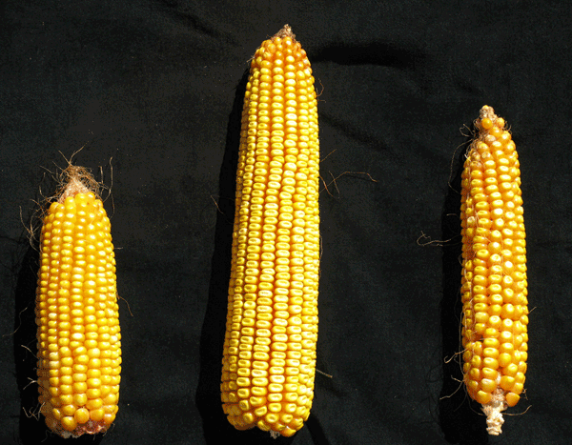
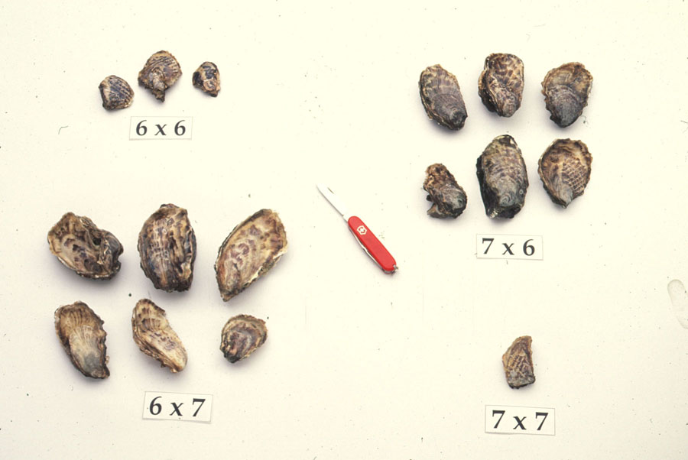
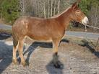
Heterosis Observations
Hybrid Vigor is similar in very different species
Hybrids are more stress-resistant
“Inbreeding depression” is the opposite
Very basic cellular phenomena
Protein degradation is lower in hybrids
Growth rate is higher in hybrids

Slide 16
Heterosis Experimental Strategy: Maize
What genes are responsible for yield?
12 samples: maize inbreds, crosses and reciprocal crosses :
A and B - inbreds from one heterotic group
X and Y - inbreds from a complementary group
Leaves Sampled for RNA expression (V4 & V5)
Also done for inbred versus hybrid rice
Heterotic
Group #1
Heterotic
Group #2
A
X
B
Y
Syngenta Seeds and Biotechnology - Unpublished

Slide 17
Inbreds versus Hybrid
Same Phenomena in All Inbreds vs Hybrid Examined
UPS Lower in all Hybrids
Inbred
Stress Response Gene Expression (sum of 18 genes)
High Heterosis
High Heterosis
High Heterosis
Distant hybrid
No Heterosis
Low Heterosis
Low Heterosis
High Heterosis
Low Heterosis
High
Increasing heterosis
Syngenta Seeds and Biotechnology - Unpublished

Slide 18
UPS – Ubiquitin Proteasome System
E1
E1
E2
E2
Substrate
AMP +PP
E3
Ubiquitin + ATP
Substrate
>1,300 UPS Genes in Arabidopsis and rice
Proteosome

Slide 19
Is Protein Metabolism Different in Inbreds versus Hybrids?

Slide 20
Heterosis in Pacific Oysters
Genes expressed in inbred vs hybrid oysters
Protein degradation higher in Inbreds
    Proteins from Ubiquitin proteasome System
Growth rate Inversely correlated with inbreeding
Less protein metabolism - faster growth
D. Hedgecock et al. (2007) Transcriptomic analysis of growth heterosis in larval Pacific oysters (Crassostrea gigas) PNAS 104; p2313-2318

Slide 21
BGI – SAGE Analysis of Super Hybrid Rice
Serial Analysis of Gene Expression (SAGE) – 465k tags
“Most of the down-regulated genes in the hybrid were found related to protein processing (maturation and degradation).”
Examples included:
UBC2 - ubiquitin-conjugating enzyme for unfolded proteins
PPIase – Rate limiting step in protein folding
Many genes up- or down-regulated
Did not formulate model
Bao et al. “Serial analysis of gene expression study of a hybrid rice strain (LYP9) and its parental cultivars. Plant Physiology July 2005 138; pp1216-1231.

Slide 22

Protein Turnover connected to Heterosis in Mytilus edulis
Majority of growth differences explained by protein turnover
~ 2/3 variation in growth explained by differences in metabolic efficiency
~ 1/3 by variation in feeding rates
Also demonstrated for oysters, starfish, mussels & finfish
Garton, et al Genetics 108;445-455 (1984)
Hawkins & Day Amer.Zool. 39;401-411 (1999)
More recent papers by Donal Manahan & Dennis Hedgecock (USC)
Growth
Protein Metabolism
Level of Heterosis
Level of Heterosis

Slide 23
Attempts to Understand Hybrid Vigor by Gene Expression
Pioneer HiBred with maize - Open profiling
BGI with super-hybrid rice - SAGE
Stupar & Springer - Affymetrix chips
TMRI - Affymetrix chips, rice and maize
Summary:
Many genes go up, many go down
No common pathways between lines
Protein Metabolism down in hybrids
Yield inversely correlated with non-additive changes

Slide 24
Does Protein Metabolism Require a Significant Amount of Energy?

Slide 25
What Pathways Consume the Most Energy?
Survival in hypoxia & low ATP production
(turtles, snails, lungfish, frogs, diving mammals, etc)
How? Reduction of metabolism by as much as 10-fold
What metabolic pathways are reduced
How much energy do they save?
Protein synthesis & degradation – 25-30%
Na⁺/K⁺ ATPase – 19-28%
Ca²⁺ ATPase – 4-8%
Actinomyosin ATPase – 2-8%
Gluconeogenesis – 7-10%
Urea synthesis – 3%
R.G. Boutilier – “Mechanisms of cell survival in hypoxia and hypothermia.” J. Exp. Biol. 204, p3171 (2001).
P.W. Hochachka et al - "Unifying theory of hypoxia tolerance: molecular/metabolic defense and rescue mechanisms for surviving oxygen lack." PNAS 93, p9493 (1996).

Slide 26
Is Protein Metabolism Correlated with Growth Rate?

Slide 27
Changes in protein degradation in regenerating livers
O. A. Scornik and V. Botbol
During liver regeneration rates of protein deg slowed to one-half the normal values
Changes in the rate of protein degradation are single most important factor in liver compensatory growth
Growth Inversely Related to Protein Turnover
JBC, 251 p2891-2897 (1976)

Slide 28
Skeletal muscle growth and protein turnover in a fast-growing rat strain
P. C. BATES AND D. J. MILLWARD
Protein turnover studied in rat skeletal muscle throughout development in slow & fast growing rats
Faster growth achieved mainly by lower rates of protein degradation
Growth Inversely Related to Protein Turnover
Br. J. Nutr. 46, pI7 (1981)

Slide 29
Is Energy Use Efficiency
Under Evolutionary Selection?

Slide 30
Energy Use Efficiency is under selective pressure
Metabolic Costs of Amino Acid Biosynthesis
Amino acid ~P_{eq}
Amino acid ~P_{eq}
Ala 11.7
Gly 11.7
Ser 11.7
Asp 12.7
Asn 14.7
Glu 15.3
Gln 16.3
Thr 18.7
Pro 20.3
Val 23.3
Cys 24.7
Arg 27.3
Leu 27.3
Lys 30.3
Ile 32.3
Met 34.3
His 38.3
Tyr 50.0
Phe 52.0
Trp 74.3
Akashi & Gojobori (2002) Metabolic efficiency and amino acid composition in the proteomes of Escherichia coli and Bacillus subtilis. PNAS 99; pp3695-3700

Slide 31
Energy Use Efficiency is under selective pressure
Metabolic Costs of Amino Acid Biosynthesis
Bacillus subtilis
E coli
Energy Required
Energy Required
Codons in Genome
Codons in Genome
Akashi & Gojobori (2002) Metabolic efficiency and amino acid composition in the proteomes of Escherichia coli and Bacillus subtilis. PNAS 99; pp3695-3700

Slide 32
Essential Amino Acids +
Conditionally Essential Amino Acids
Amino acid ~P_{eq}
Amino acid ~P_{eq}
Ala 11.7
Gly 11.7
Ser 11.7
Asp 12.7
Asn 14.7
Glu* 15.3
Gln 16.3
Thr 18.7
Pro 20.3
Val* 23.3
Cys 24.7
Arg*27.3
Leu*27.3
Lys 30.3
Ile* 32.3
Met 34.3
His 38.3
Tyr* 50.0
Phe 52.0
Trp* 74.3
* = Ile, Val, Tyr, Trp, Arg, Glu, and Leu correlated with thermotolerance
Evolution eliminated biosynthesis of costly amino acids
from many higher organisms

Slide 33
Is Gene Expression Linked to Protein Stability?

Slide 34
Protein Folding & Aggregation Diseases in Humans
α-Antitrypsin deficiency
Fabry (lipid metabolism)
Spinocerebellar ataxia
Sickle cell anemia
Fatal familial insomnia
Polyglutamine diseases
Prion diseases
MS
Alzheimer’s
Parkinson’s
Huntington’s
Creutzfeldt-Jakob
Cystic fibrosis
Gaucher’s
Emphysema
Chronic liver disease
Nephrogenic diabetes insipidis
”Protein misfolding could be involved in up to half of all human diseases” Susan Lindquist MIT

Slide 35
Mutant Rescue
Proteasome Inhibition & Folding Enhancement
Cystathionine ß-Synthase (CBS)
CBS mutations cause homocystinuria
Many alleles with nonsynonymous aa substitutions
CBS genes can be expressed in yeast
  WT CBS gene complements yeast auxotroph
  Mutant CBS genes do not
17 of 18 mutants rescued by proteasome inhibitors
True for TP53 mutants (Li-Fraumeni Syndrome) &
MTHFR mutants (methylenetetrahydrofolate deficiency)
Bortezomib, EtOH, and Hsp26 mutants all work
MG132 rescues activity in patient fibroblasts
Functional rescue of mutant human cystathionine ß-synthase by manipulation of hsp26 and hsp70 levels in Saccharomyces cerevisiae. JBC 284(7) p4238-4245 (2009).
Activation of Mutant Enzyme Function In Vivo by Proteasome Inhibitors and Treatments that Induce Hsp70. Singh, Gupta, Honig, Kraus, & Kruger. PLoS Genetics Vol 6(1) e1000807 (2010)

Slide 36
Cystathionine β-Synthase
O
O
SH
O-
+
HO
O-
NH₃
NH₃
Homocysteine
Serine
Cystathionine β-Synthase
H₂O
O
NH₃
S
O-
O-
Cystathionine
NH₃
O
H₂O
Structure Known
Many mutants known
Disease = homocystinuria
NH₄⁺
O
O
O-
CH₃
HS
O-
O
NH₃
α-Ketobutyrate
Cysteine

Slide 37
Rescue of Defective CBS Proteins by Enhanced Folding
Mutant Rescued in Yeast Rescued in Mice
G307S ΔHsp26 Not tested
T262M EtOH/Bortezomib MG132
D376N ΔHsp26 Not tested
T353M EtOH/ΔHsp26/Bortezomib MG132
A231L EtOH/ΔHsp26 Not tested
T191M ΔHsp26 Not tested
G151R Bortezomib (35%) Not tested
L101P Bortezomib (28%) Not tested
N228S ΔHsp26/Bortezomib Not tested
Q528K Bortezomib (17%) Not tested
L496P ΔHsp26 Not tested
G116R Not Rescued Not tested
A114V Bortezomib Not Rescued (Het)
V320A ΔHsp26/Bortezomib Not tested
R224H EtOH/Bortezomib Not tested
V168M ΔHsp26 Not tested
A226T ΔHsp26/Bortezomib Not tested
I278T EtOH/ΔHsp26/Bortezomib MG132
Singh et al. PLoS Genetics 6(1): e1000807 (2010)
Singh & Kruger. JBC 284: p4238-4245 (2009)

Slide 38
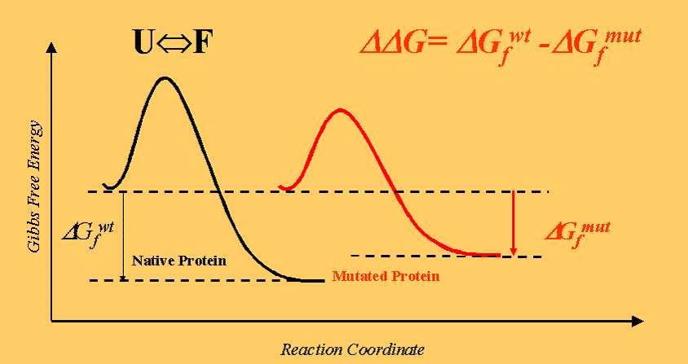
Computational Analysis of CBS Mutant Stability
Mutant Stability RI Free energy
G307S Decrease 8 -1.96
T262M Decrease 5 -0.6
D376N Decrease 7 -1.98
T353M Increase 2 0.52
A231L Increase 5 0.15
T191M Decrease 5 -0.01
G151R Decrease 8 -2.48
L101P Decrease 7 -1.66
N228S Decrease 8 -0.86
Q528K Decrease 1 -0.62
L496P Decrease 4 -0.94
G116R Decrease 9 -1.92
A114V Decrease 2 -0.7
V320A Decrease 10 -2.9
R224H Decrease 8 -1.69
V168M Decrease 7 -0.26
A226T Decrease 8 -1.15
I278T Decrease 8 -1.63
i-Mutant2.0
Juan Antonio Raygoza Garay
Eric Lyons

Slide 39
PIT1 Disease Mutants
Generation
Mutation = Arg271Trp
male
I
female
II
male
carrier
III
female
carrier
Monoallelic expression of normal mRNA in the PIT1 mutation heterozygotes with normal phenotype and biallelic expression in the abnormal phenotype.
Okamoto et al (1994) Human Molecular Genetics 3(9): 1565-1568
proband
mscqaftsadtfiplnsdasatlplimhhsaaeclpvsnhatvmstatglhysvpschy
gnqpstygvmagsltpclykfpdhtlshgfppihqpllaedptaadfkqelrrksklvee
pidmdspeirelekfanefkvrriklgytqtnvgealaavhgsefsqtticrfenlqlsf
knacklkailskwleeaeqvgalynekvganerkrkrrttisiaakdalerhfgeqnkps
sqeimrmaeelnlekevvrvwfcnrrqrekrvktslnqslfsiskehlecr
deceased

Slide 40
Paradoxical Gene Expression in Disease
ORF
Stop Codon
Wild type gene
Proteins
AAAATAAAA
ORF
Stop Codons
Mutant gene
Wild type
Het
Homo. Mutant
AAAAAAAA
Low disease gene expression in heterozygote
Low disease symptoms in some homozygous cases
Disease genes encode less stable proteins
Examples include:
  Canine cyclic neutropenia (stem cell disease)
  Hemophilia A (factor VIII)
  Apolipoprotein B (compound heterozygous mutant)
  Osteopetrosis (carbonic anhydrase II)
  Dominant negative PIT1 gene (pituitary regulator)

Slide 41
Is Protein Folding & Degradation Connected to Yield in Aneuploids or Polyploids?

Slide 42
Monosomic Effect on Heterosis for 1S
90
BB
80
BM
70
MB
60
MM
50
40
Plant height (cm)
30
20
10
0
Monosomics
Diploids
Trisomics
Slide Courtesy of Jim Birchler, University of Missouri

Slide 43
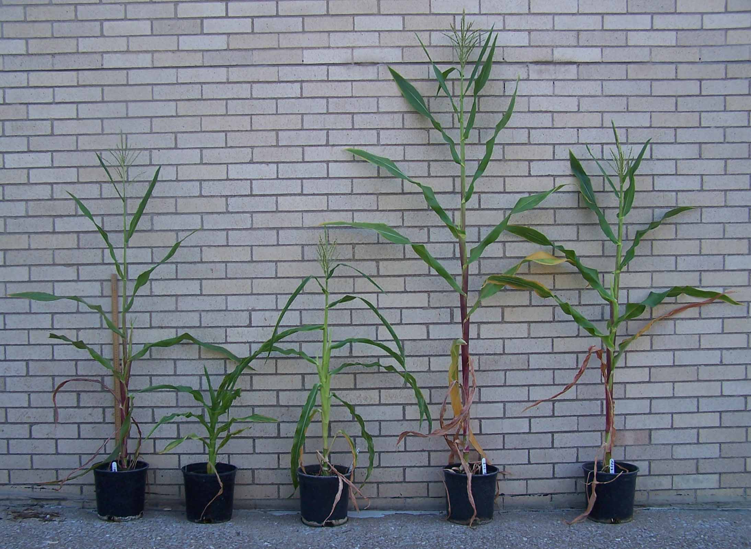
Haploid, haploid + 1L, monosomic 1L, diploid, trisomic 1L
1L Family Portrait
Haploid Haploid+1L Monosomic@1L Diploid Trisomic 1L
Slide Courtesy of Jim Birchler, University of Missouri

Slide 44
Why do Aneuploids Grow Slower?
Strain Construction
Growth, Gene Expression
Saccharomyces cerevisiae - diploid
Aneuploidy decreases growth per unit glucose consumption:
Increased glucose consumption
Expression proportional to dose
Sensitive to protein synthesis & folding
Higher protein deg
Longer cell cycle
Dependent on protein products
DNA doesn’t matter, proteins do
Haploid
Disomics
Haploid plus YAC
Effects of aneuploidy on cellular physiology and cell division in haploid yeast.
Torres et al Science 317, p916 (2007)

Slide 45
Quality Control in the Nucleus & Regulation by Protein Metabolism

Slide 46
Transcription, Translation, & mRNA Degradation Linked
RNA Polymerase II subunits Rbp4p and Rbp7p (yeast)
Previously known to be involved in mRNA decay
Physically interact with translation initiation factor 3 (eIF3)
eIF3 serves as scaffold for translation factors
Shuttle between nucleus and cytoplasm with mRNAs
Proposed to be “mRNA Coordinators”
Rpb4/7 mediate deadenylation (leads to mRNA decay)
Yeast mRNAs can exist in “Stress Granules” in transit
Do these Pol II Factors Shuttle tested mRNAs?
Harel-Sharvit et al, (2010) RNA Polymerase II subunits link transcription and mRNA decay to translation. Cell 143:552-563.

Slide 47
Hybrids Display Altered Circadian Rhythms
Altered circadian rhythms regulate growth vigour in hybrids and allopolyploids. Ni et al. Nature 457: p327-331 (2009).
Molecular mechanisms of polyploidy and hybrid vigor. Z. Jeffrey Chen. Trends in Plant Science 15(2): p 5771 (2010).
Circadian Clock Associated 1 (CCA1)
Late Elongated Hypocotyl (LHY)
Timing of CAB Expression 1 (TOC1)
Gigantea (GI)
Arabidopsis thaliana & Arabidopsis arenosa used as model system
Hybrids grow faster & larger
Hybrids & allotetraploids - increased starch & sugar accumulation & metabolism
What is the underlying cause?
Display altered expression in hybrids & allotetraploids

Slide 48
Protein Breakdown and Cell Number
Mei Guo – Pioneer HiBred
Studying Cell Number Regulator 1 - Maize CNR1 Gene
CNR1 is homolog (ortholog) of tomato FW2.2 gene
Controls cell number
More CNR1 expression - lower cell number
More CNR1 - lower growth rate
Ubi Promoter driven CNR1 causes decreased growth
CNR1 RNAi show slightly more biomass & yield
CNR1 - Cadmium or Calcium transport protein
Note: Cadmium is a heavy metal
Heavy metals denature proteins

Slide 49
How can it be used to create a computationally-driven molecular breeding pipeline?

Slide 50
Stability Value Analysis Pipeline
In PDB?
Allele Sequence
No
Homology
Alignment
Yes
Structural
Alignment
Relative
Stability
Database of All Allele Stability Values

Slide 51
Defect Elimination Workflow
Allele
Specific
Exp?
SNP Detection
Hold
UHT RNA Seq
Inbreds/Hybrids
No
Transcript Abundance
Yes
Down-Reg in Hybrid?
Hold
MAB Program
Yes
No
Yield Trials
RepeatCycles
Eliminate Alleles

Slide 52
Use Markers to Replace Weak Alleles
Defective Allele - Parent 1
Defective Allele - Parent 2
1
2
3
4
5
6
7
8
9
10

Slide 53
Complemetation in Hybrids - Dominance
Weak/defective Homozygous Alleles
Hybrid, one good one weak allele
Abundant Weakly Active Protein
Weak + Active Protein
Activity Range
Activity Range
Activity
Activity
Condition (temp, pH, etc)
Condition (temp, pH, etc)

Slide 54
Complemetation in Hybrids - Over-Dominance
Weak/defective Homozygous Alleles
Complementing Heterozygous Alleles
Abundant Weakly Active Protein
Active Protein
Activity Range
Activity Range
Activity
Activity
Condition (temp, pH, etc)
Condition (temp, pH, etc)

Slide 55
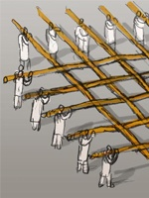
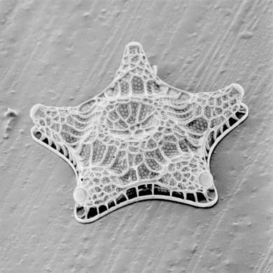
Thanks for your Attention
Questions & Comments Appreciated
sgoff@iplantcollaborative.org

